Slide 1
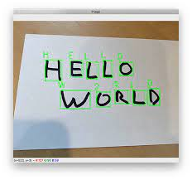
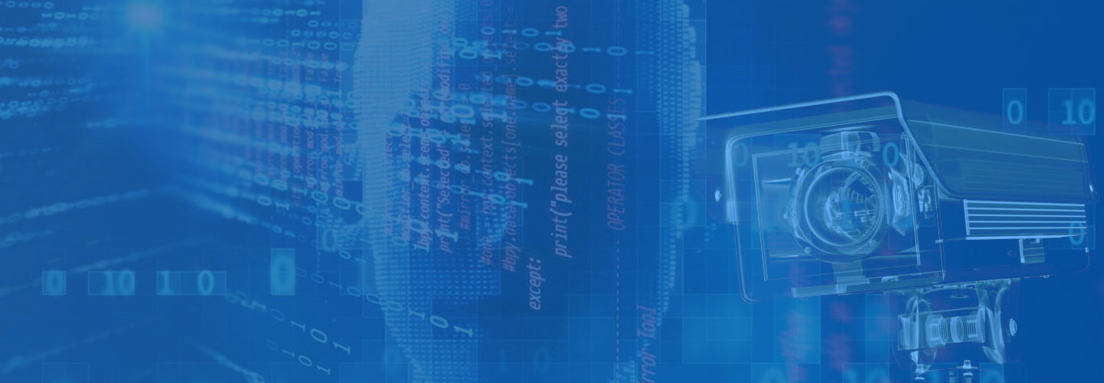
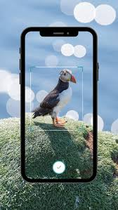
Flex Lens
Object Detection
&
Handwriting Recognition
System
- by ROHAN GHOSH

Slide 2

“Flex Lens” can recognize handwritten stuffs and digitize them for use in various purpose in this superfast evolving environment, where Metaverse is pep talk. And object detection and recognition for faster processing of intermediatory tasks. It has a widefield application in security cameras, for developing systems for physically disabled peoples, etc.
Conclusively, “Flex Lens” is a smarter, faster and better system for the flexibility in our day-to-day life. Hence, making the earth a better place.
& Handwriting Recognition

Slide 3

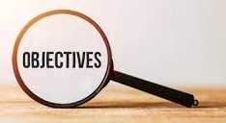
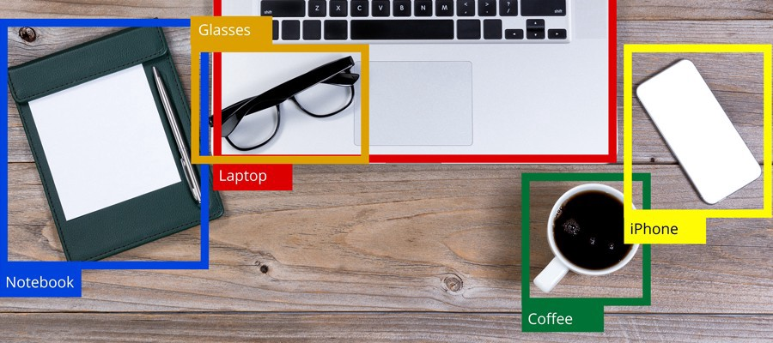

The main purpose of object detection is to identify and locate one or more effective targets from still image or video data. It comprehensively includes a variety of important techniques, such as image processing, pattern recognition, artificial intelligence and machine learning.
It has broad application prospects in such areas such as road traffic accident prevention, warnings of dangerous goods in factories, military restricted area monitoring and advanced human–computer interaction.
Since the application scenarios of multi-target detection in the real world are usually complex and variable, balancing the relationship between accuracy
and computing costs is a difficult task.

Slide 4




Technology Used
The project, Flex Lens is based on Deep Learning. We have introduced
the concept of Convolutional Neural Network (CNN) to make an AI system which can recognize handwriting and detect object, since it automatically detects the important features without any human supervision and has very high accuracy in image recognition problems. Using Jupyter Notebook we have recorded our datasets and used Tensorflow for storing image data and object detection.
Our system is capable of identifying objects based on pre-stored image sets. Moreover, it is capable of capturing, storing new image sets and identifying them. Since, it is a self-learning system which will gather the experience for its self-development.

Slide 5

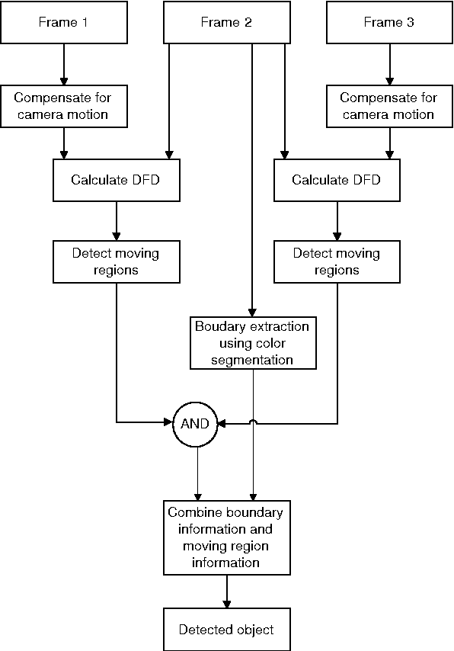
Designs
DFD
MODEL

Slide 6

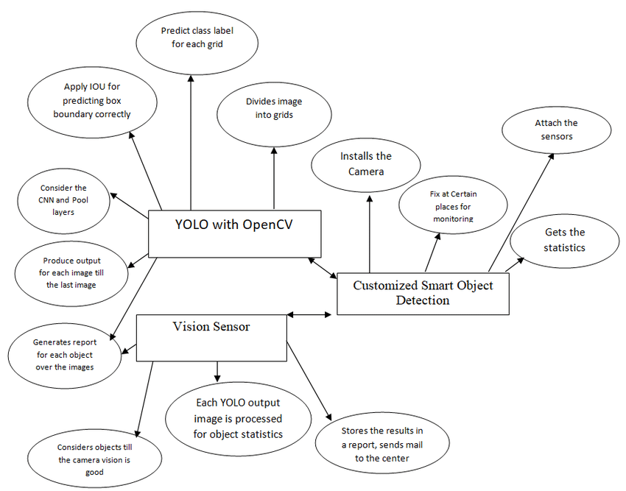
ER MODEL

Slide 7
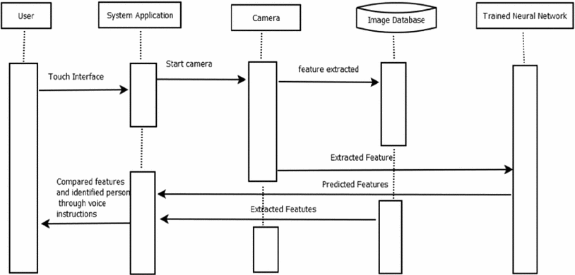
SEQUENCE DIAGRAM

Slide 8

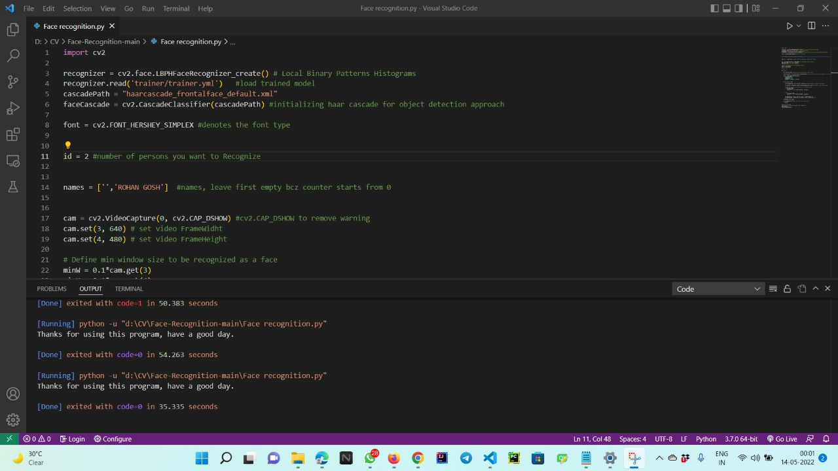
Snapshot-1

Slide 9

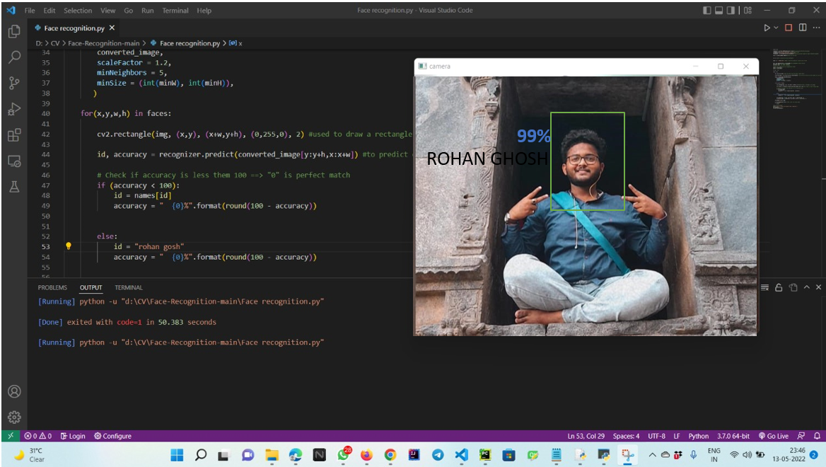
Snapshot-2

Slide 10

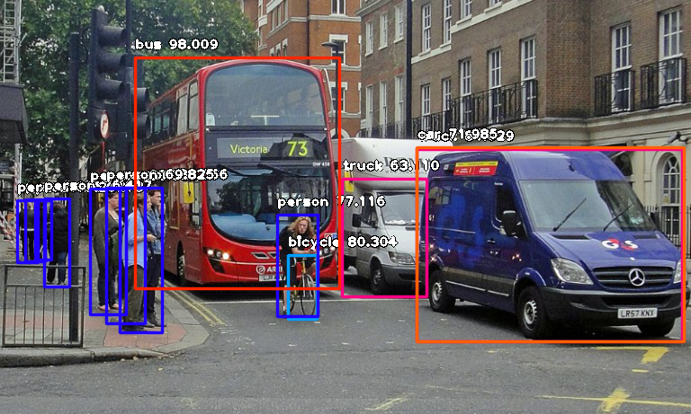

Outcomes
Deep-learning based object detection has been a search hotspot in recent
years. This project starts on generic object detection pipelines which give
base architectures for other related tasks. With the assistance of this the
3 other common tasks, namely object detection, face detection and pedestrian detection, are often
accomplished
Object detection also finds use in tracking of objects through video sequence
like prediction of object’s future position after detecting it in the past video frames,
automatic annotating of faces in live video for further analysis (recognition and labelling) etc.

